Slide 1




I Can Hear You Without a Microphone: Live Speech Eavesdropping From Earphone Motion Sensors
Yetong Cao∗, Fan Li∗, Huijie Chen†, Xiaochen Liu∗, Chunhui Duan∗, Yu Wang‡
*Beijing Institute of Technology, China
†Beijing University of Technology, China
‡Temple University, USA
INFOCOM 2023

Slide 2



Background
As earphones become more ubiquitous, there is growing concern about the loss of conversational information.
Private speech, personal information
Can the motion sensors embedded in earphones pick up the wearer’s speech during everyday life?
Motion sensors in earphones provide good sensing capability and unrestricted access.
Attack
Speech
Motion sensors

Slide 3
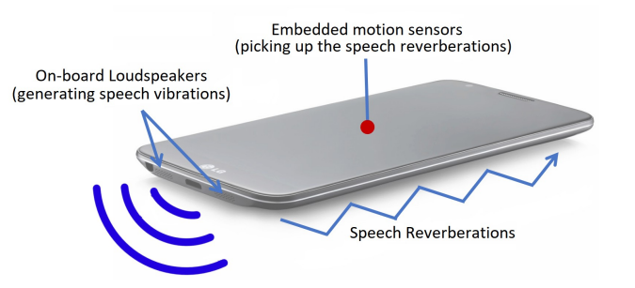
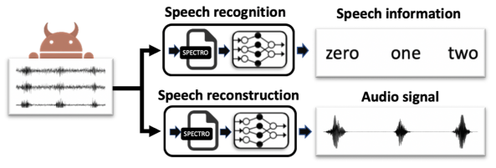

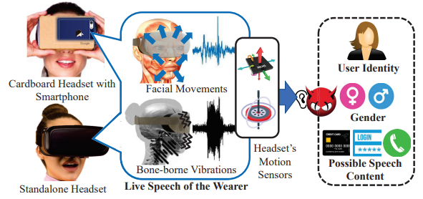
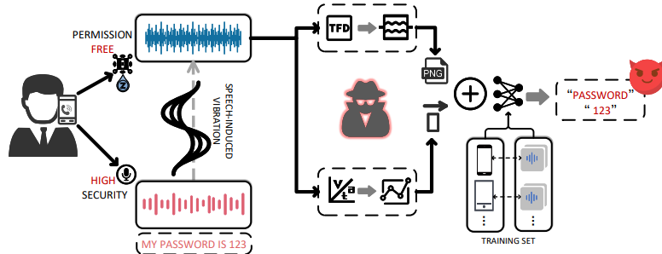
Existing Works
Motion sensors are sensitive enough to measure sound vibrations.
They can not be applied to speech eavesdropping via earphones.
Gyrophone
S&P’18
AccelEve
NDSS’20
Different signal patterns.
More complicated interference.
No additional data.
Vibphone
UbiComp’21
FaceMic
MobiCom’21

Slide 4
Basic Idea
Ear Canal Dynamic Motions (ECDMs)
Motion Sensor
Bone Conduction Vibrations (BCVs)

Slide 5
Basic Idea
Ear Canal Dynamic Motions (ECDMs)
BCVs
Motion Sensor
ECDMs
Bone Conduction Vibrations (BCVs)

Slide 6
Capturing Ear Dynamics Using Motion Sensors
Ear
Throat
Conclusion
The earphone’s accelerometer successfully captures the BCVs ($>$ 50 Hz).

Slide 7
Capturing Ear Dynamics Using Motion Sensors
Vertical acceleration
Power spectral density
Conclusion
The earphone’s accelerometer successfully captures the ECDMs ($≤$ 50 Hz).

Slide 8

Interference
Causes of interference:
Body motion ($≤$ 10 Hz).
Earphone’s speaker playing audio ($>$ 50 Hz).
Conclusion
Eliminating interference of body motion and audio is critical.

Slide 9
EarSpy
Challenge 1: How to remove interference?
Challenge 2: How to handle individual differences?
Challenge 3: How to devise an accurate model?

Slide 10
Speech Detection
Calculate the linear acceleration (LA) of components below and above 50Hz, respectively.
Identify the beginning and end of the speech when two LAs are above/below two thresholds.
Head motion
Speech
High-frequency component (BCVs)
Audio
Low-frequency component (ECDMs)
0.2 times of the maximum value of LA

Slide 11
Profiling Ear Dynamics：ECDMS
Body motion interference elimination for ECDMs:
Eliminate the body motion interference using the deep regression model proposed by FaceMic (MobiCom’21).
ECDM representation extraction:
Extract the envelope of a total of six acceleration axes collected from the two ears as the representation of ECDMs.

Slide 12
Profiling Ear Dynamics：BCVs
Audio-induced earphone vibration interference elimination for BCVs:
Separate the wearer’s speech based on pitch continuity of speech.

Slide 13
Profiling Ear Dynamics：BCVs
Audio-induced earphone vibration interference elimination for BCVs:
Separate the wearer’s speech based on pitch continuity of speech.
Distinguish between BCVs and interference based on the asymmetry of BCVs of two ears.

Slide 14
Profiling Ear Dynamics：BCVs
Audio-induced earphone vibration interference elimination for BCVs:
Separate the wearer’s speech based on pitch continuity of speech.
Distinguish between BCVs and interference based on the asymmetry of BCVs of two ears.
BCV representation extraction:
Extract the spectrogram as the representation of BCVs.

Slide 15
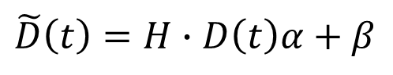
Handling User Dependence: ECDMs
ECDMs instability reduction:
Reconstruct the ECDMs based on Procrustes transformation.
Translation coefficient
$$\tilde{D}\left(t\right)=H∙D\left(t\right)α+β$$
Rotation matrix
Scaling coefficient
Procrustes transformation

Slide 16


Handling User Dependence: BCVs
Individual differences in BCVs are very compilated.
Data augmentation
&
deep learning

Slide 17
Handling User Dependence: BCVs
BCVs augmentation:
Basic idea: decompose the air-conduction speech audio of speaker A into sub-phoneme units and match that of BCVs of speaker B, then generate a new BCVs sample that maintains the voice characteristics of speaker A.
Replace units of TTS
Bilinear spectral space warping
Similar unites searching

Slide 18
Speech Recognition
CNN-CTC model:
The the password password password is 2 2 3 3 4
The password is 2 3 4

Slide 19
Implementation
Prototype
Three earphone prototypes with different structures
Data collection
14 participants (7 males and 7 females)
43 short English conversations consisting of 120 words
Each participant records 130-200 minutes
User-independent evaluation
Case study
Key algorithm evaluation
Impact factor evaluation

Slide 20
Evaluation: User-Independent Evaluation
Leave-one-participant-out evaluation:
- Use data from one participant for testing and data from the remaining participants for training.
The ratio of the number of correctly recognized words to the total number of predicted words in a sequence.
9 of the 14 participants receive precision, recall, and detection ratio above 85%.
All participants receive precision, recall, and detection ratio above 70%.

Slide 21
Evaluation: Case Study
Eavesdropping on the wearer’s speech during phone conversations:
- Three new participants (2 males and 1 female).
- Three cases: i) sitting, ii) sitting and nodding (light body motion), and iii) walking (intense body motion).
- The conversation script is designed to include “The password is” and a random 6-digits password.

Slide 22
Evaluation: Case Study
Eavesdropping on the wearer’s speech during phone conversations:
EarSpy is very accurate in the sitting case.
EarSpy is practical even when the user involves body motions.

Slide 23
Evaluation: Key Algorithms
Earphone vibration interference elimination (EVIE):
Handling user dependence:
- Case 1: EIR=0, DA=0
- Case 2: EIR=1, DA=0
- Case 3: EIR=0, DA=1
- Case 4: EIR=1, DA=1
EVIE can significantly increase the precision, recall, and detection ratio in both music and voice call cases.
EIR and DA are critical.

Slide 24
Evaluation: Practical Issues
Impact of sampling rate:
Impact of hardware difference:
- Case 1-3: leave-one-device evaluation
- Case 4: All data mixed (70% training, 30% testing)
Performance improves when sampling rate increases from 400Hz to 800Hz.
Performance come to saturation as sampling rate increases to 100Hz
Mixed data improves system performance.

Slide 25
Conclusion
We reveal the risk of speech eavesdropping via earphone’s motion sensors.
EarSpy leverages the accelerometer to capture the speech-induced ear dynamics including BCVs and ECDMs, then parses them to infer speech content.
We present several effective methods to achieve EarSpy.
Audio-induced earphone vibration interference elimination based on pitch tracking.
ECDMs Instability Reduction based on Procrustes transformation.
Data augmentation to generate BCVs for multiple subjects based on their air-conduction speech.
Speech recognition based on CNN-CTC technology.
We design prototypes and conduct experiments with 14 participants.
EarSpy is highly effective and robust to varying sampling rates, speech loudness, and hardware.

Slide 26
Thanks!
Thanks!
Thanks!
&
&
&
Questions
Questions
Questions
Yetong Cao
yetongcao@bit.edu.cn

